Slide 1
HARLEY WEBB’S PHOTOS all © to Philip Webb
Photos 1948-53 and around 1941

Slide 2
Photographs taken by Harley Webb when he was stationed at RAF Haverigg in 1941 and later,1948-1953, when his family and step-son, Philip, who kindly sent the photographs, were on holiday in Millom.
In the 1940’s the Webbs lived with the Doidge family at 45 Market St, Millom.
The photographs are in date order and some are split (with left, right or centre noted)

Slide 3
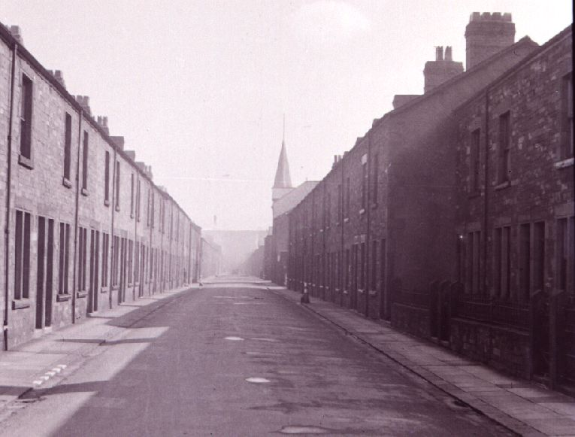
23 Mar 1941 1 pm Millom : Albert St

Slide 4
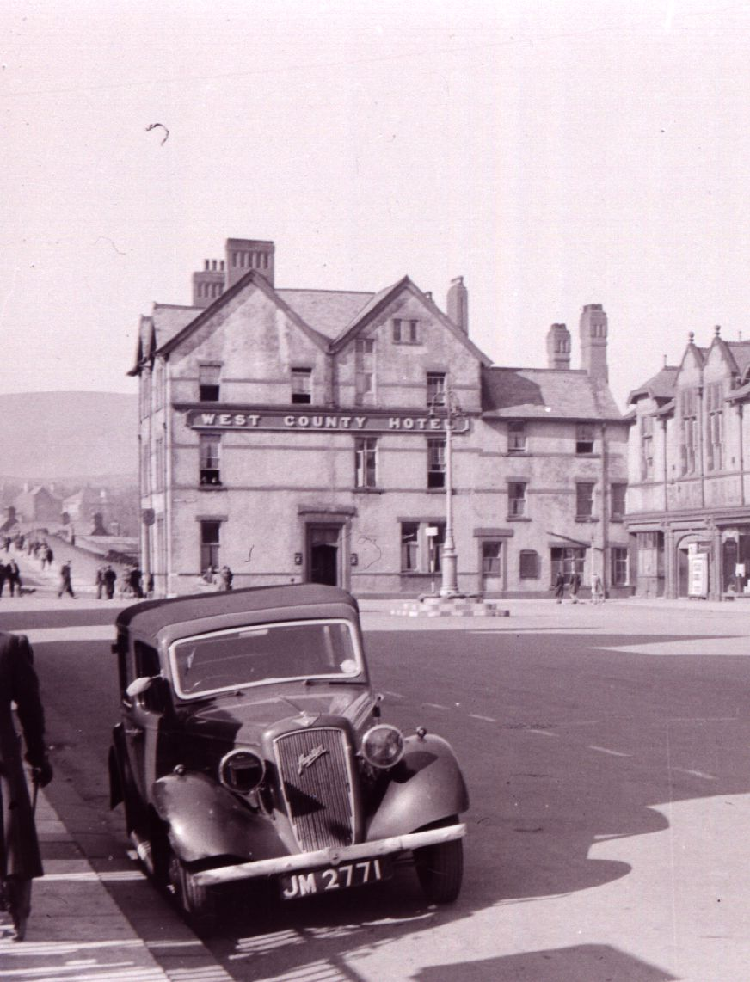
23 Mar 1941 3 pm Market Square (left)

Slide 5
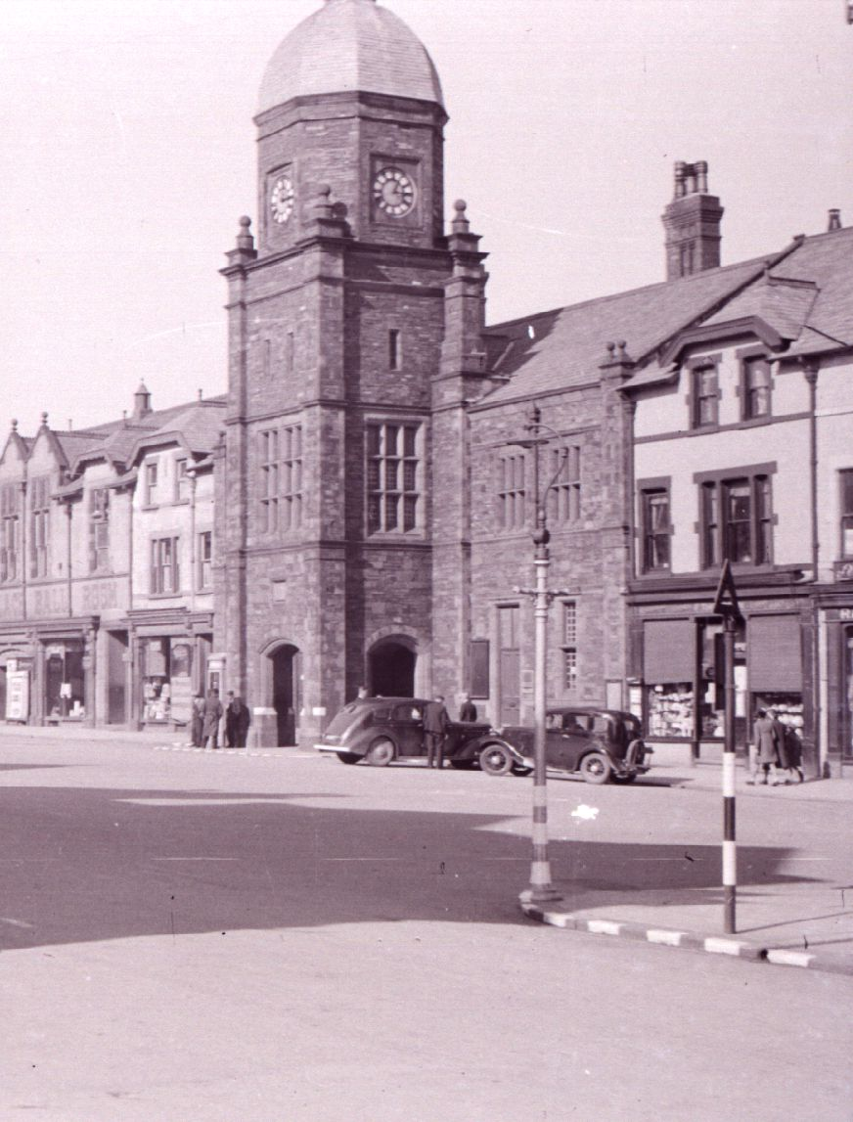
23 Mar 1941 3 pm Market Square (right)

Slide 6
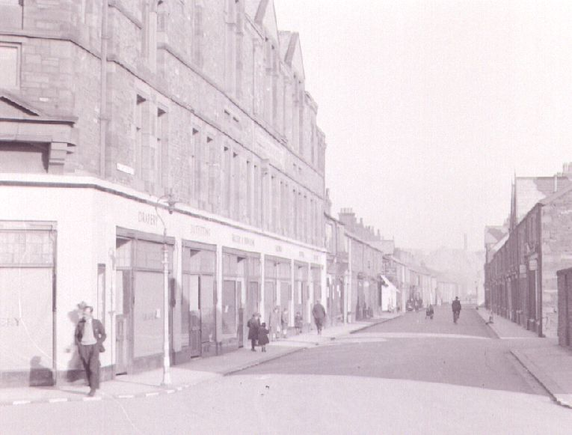
23 Mar 1941 4 pm Wellington St (left)

Slide 7
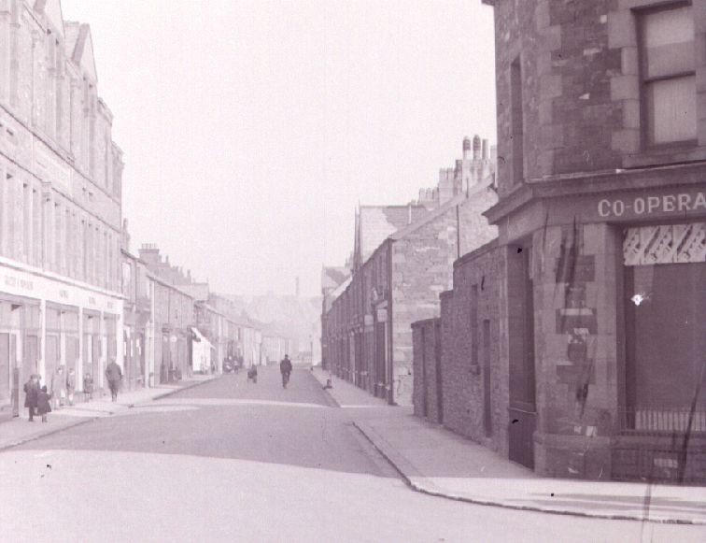
23 Mar 1941 4 pm Wellington St (left)

Slide 8
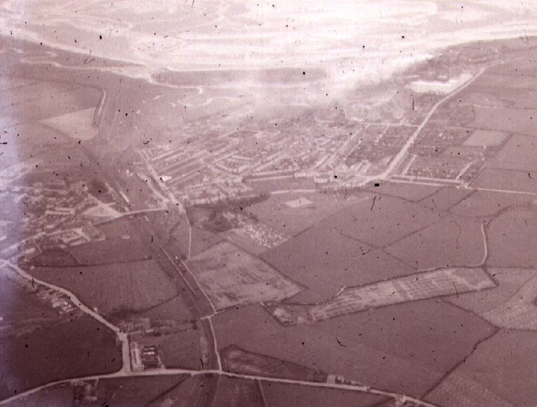
9 Ap 1941 4.30 pm Millom/Haverigg from the Air

Slide 9
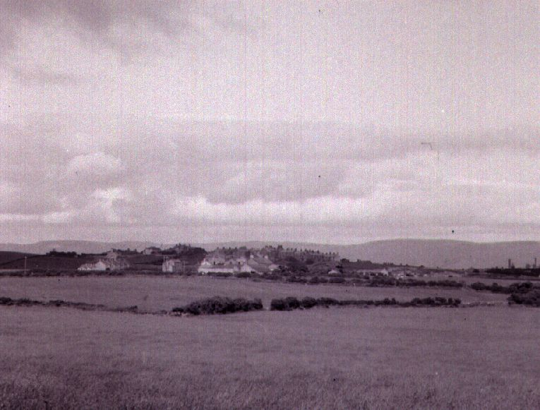
16 June 1941 6.30 pm Millom from south west

Slide 10
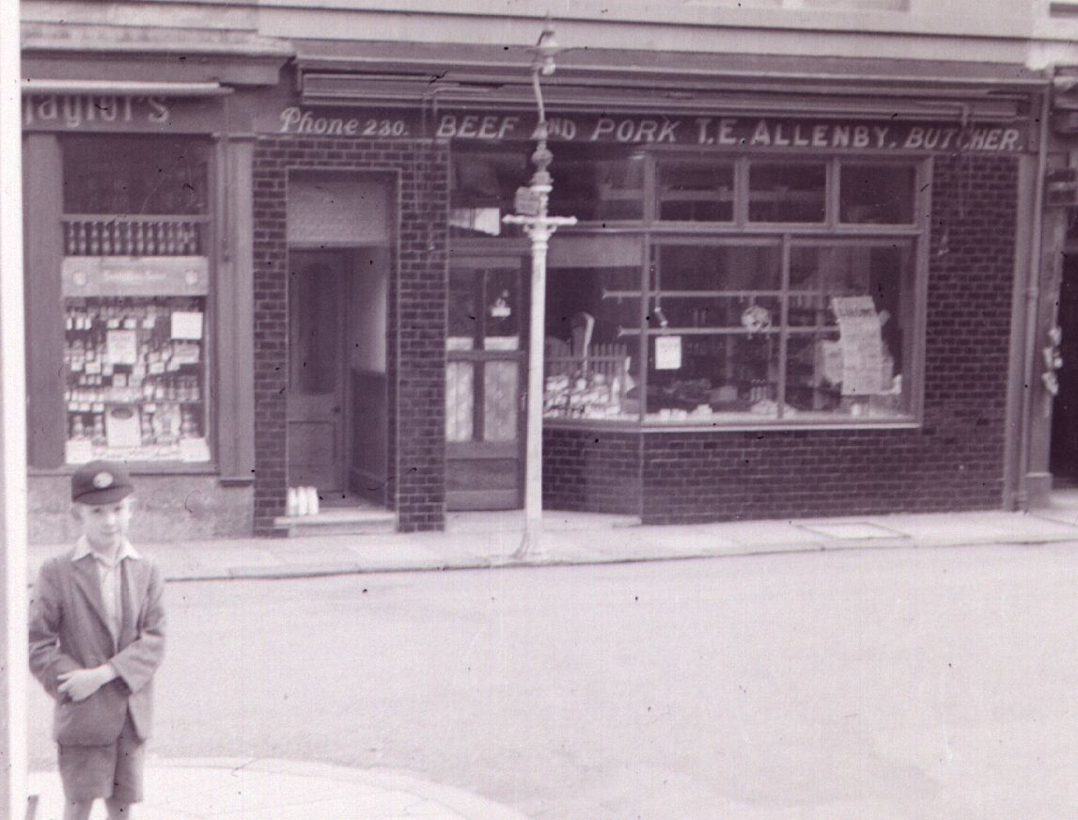
1948 Market Sq., Allenby butcher

Slide 11
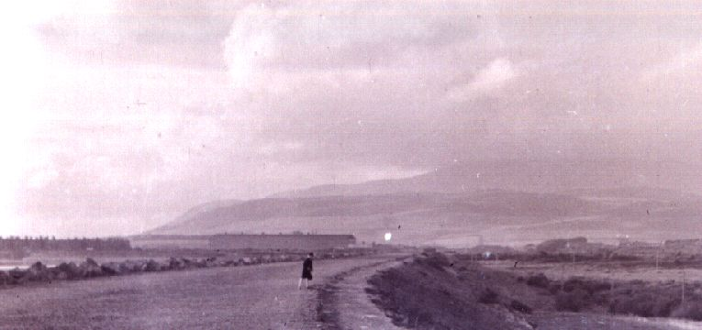
1948 Haverigg : seawall + Black Combe (left)

Slide 12
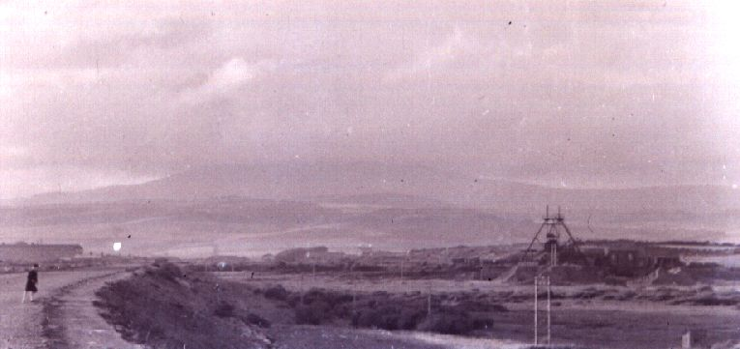
1948 Haverigg : seawall + Black Combe (right)

Slide 13
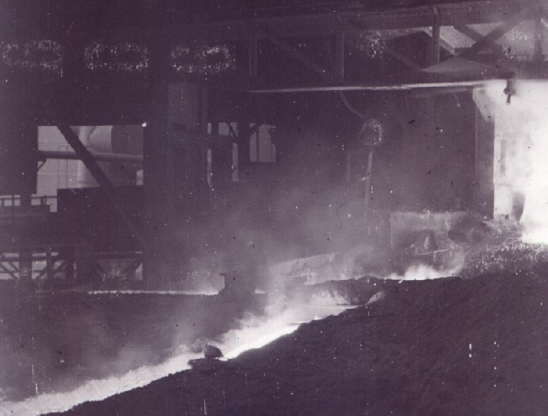
1948 Millom : Iron Works : casting (left)

Slide 14
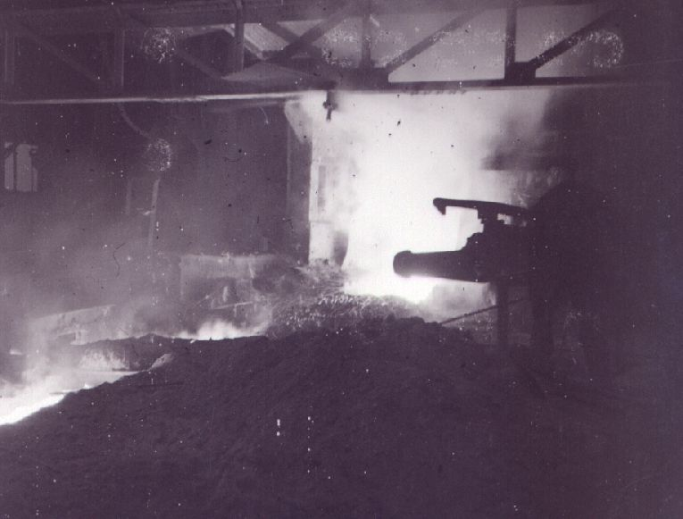
1948 Millom : Iron Works : casting (right)

Slide 15
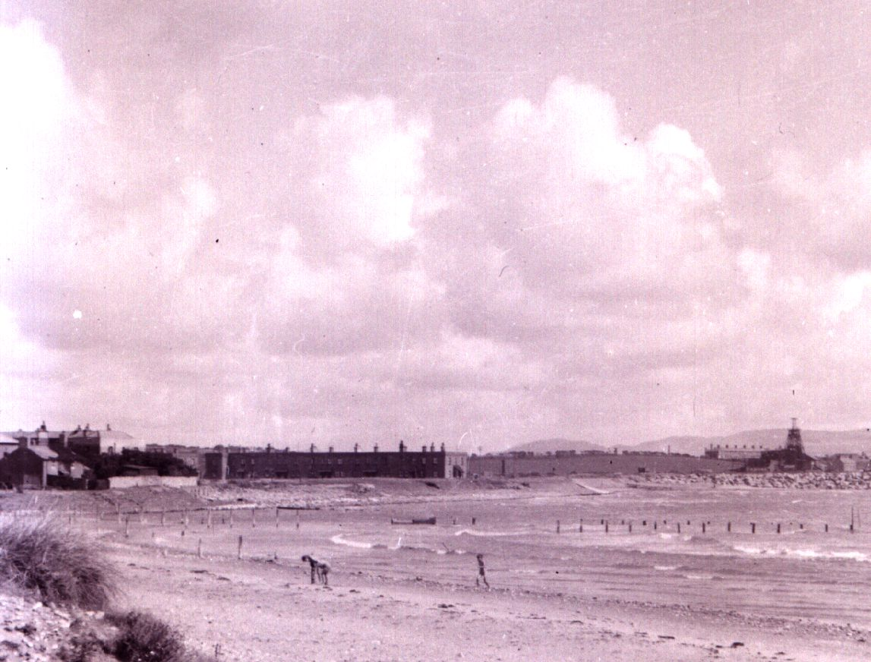
27 Aug 1950 12 pmHaverigg : seawall and Concrete Square (left)

Slide 16
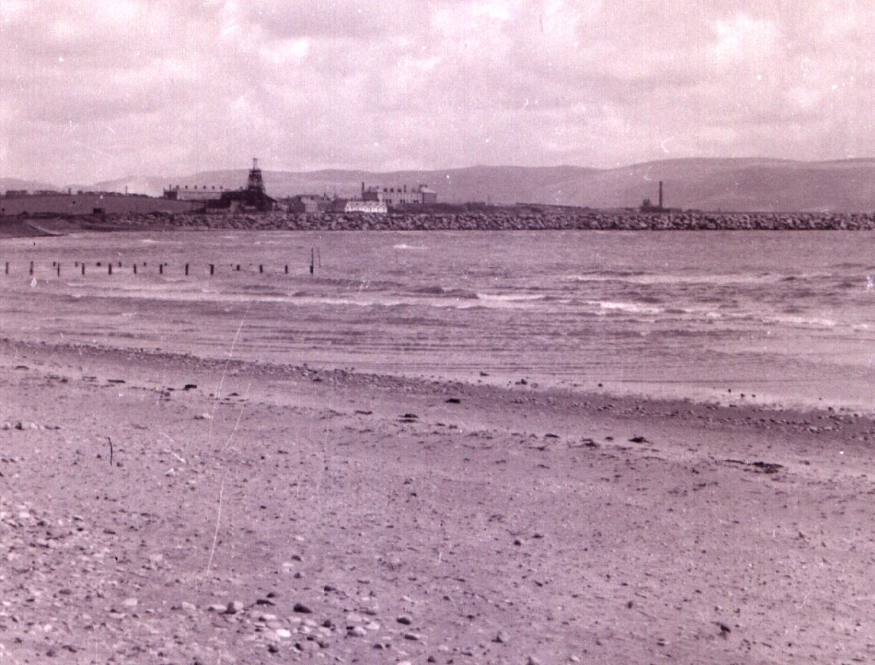
27 Aug 1950 12 pm Haverigg : seawall and Concrete Square (centre)

Slide 17
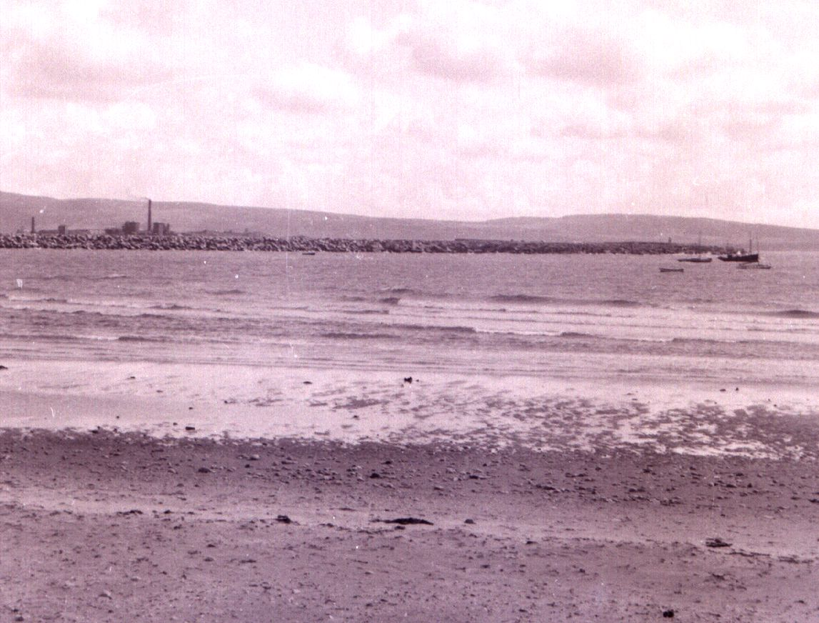
Haverigg : seawall and Concrete Square (right)

Slide 18
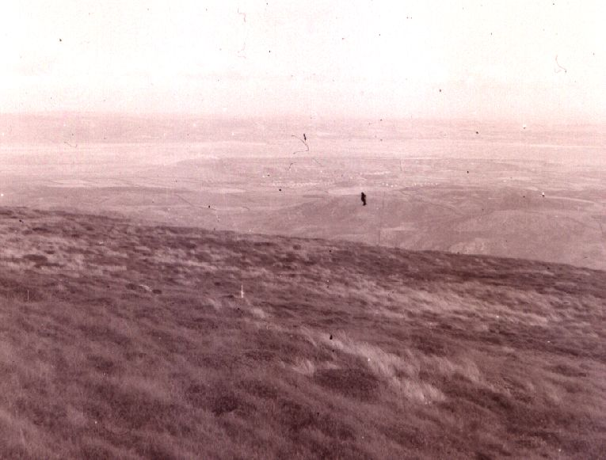
25 Aug 1953 5 pm Millom from Black Combe

Slide 19
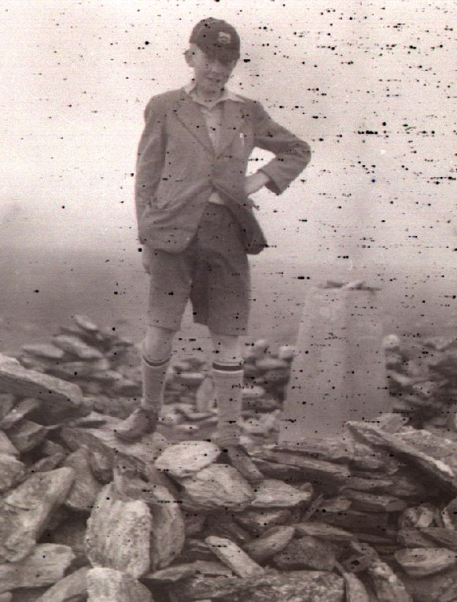
25 Aug 1953, 5 p.m. Philip Webb at Black Combe Summit,

Slide 20
THANKS
Many thanks to Philip Webb in Canada for contacting Millom and District Local History Society and sharing his step-father’s photos.

